Slide 1

Portfolio Analysis and Optimisation
Claire’s Journey of portfolio Analysis

Slide 2

Meet Claire

Slide 3

The Man

Slide 4

What is Claire thinking?
Claire wants to avoid paying ”The Man” and want to take control of her portfolio to maximise returns.
To maximise her return she needs to know
How she is performing v market?
How she can generate a better risk-adjusted return?
What future holds for her portfolio?
Can she optimize her portfolio for better returns?

Slide 5
Portfolio analysis

Slide 6
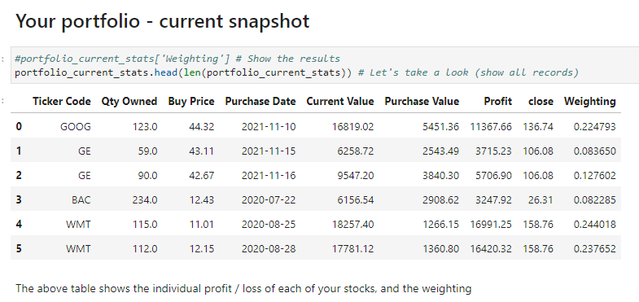

Slide 7
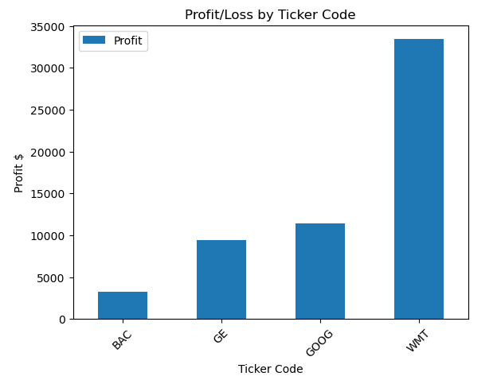

Slide 8
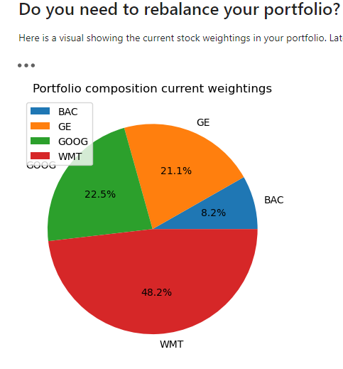

Slide 9
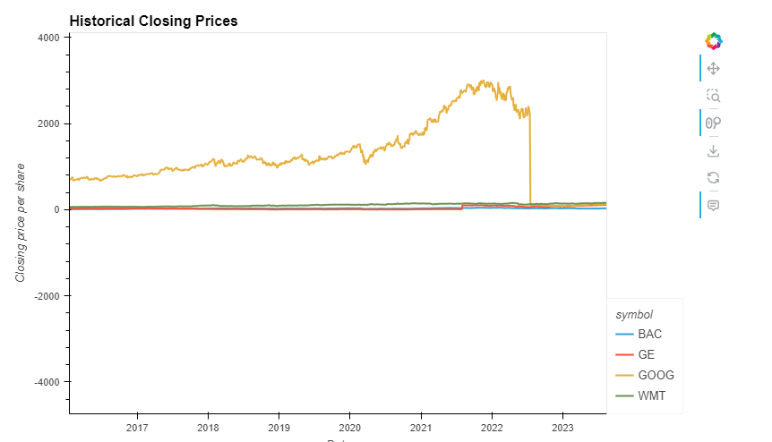

Slide 10
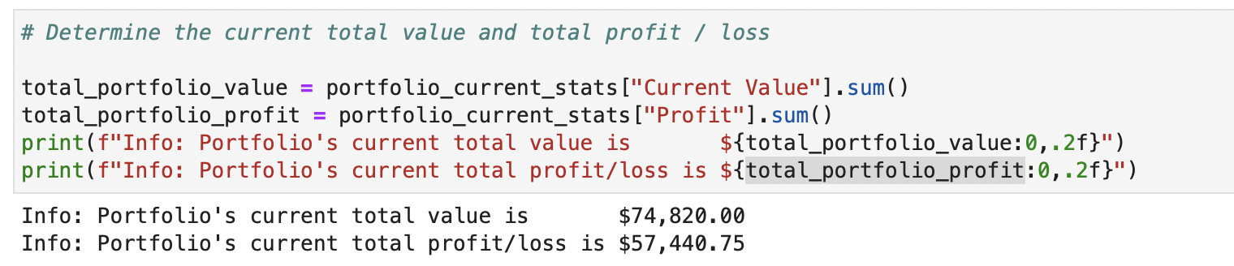
Portfolio performance

Slide 11
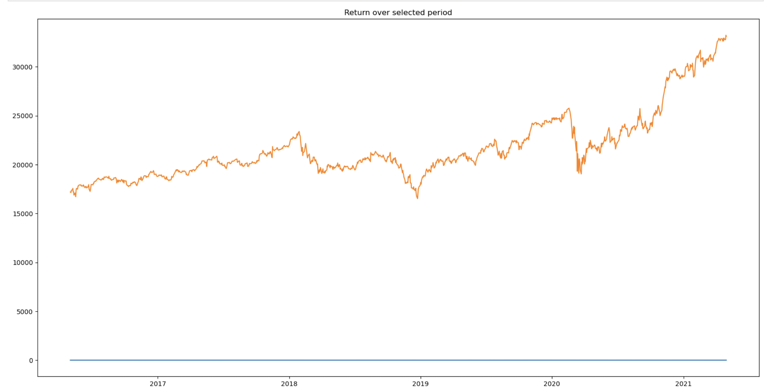
Investment Growth

Slide 12
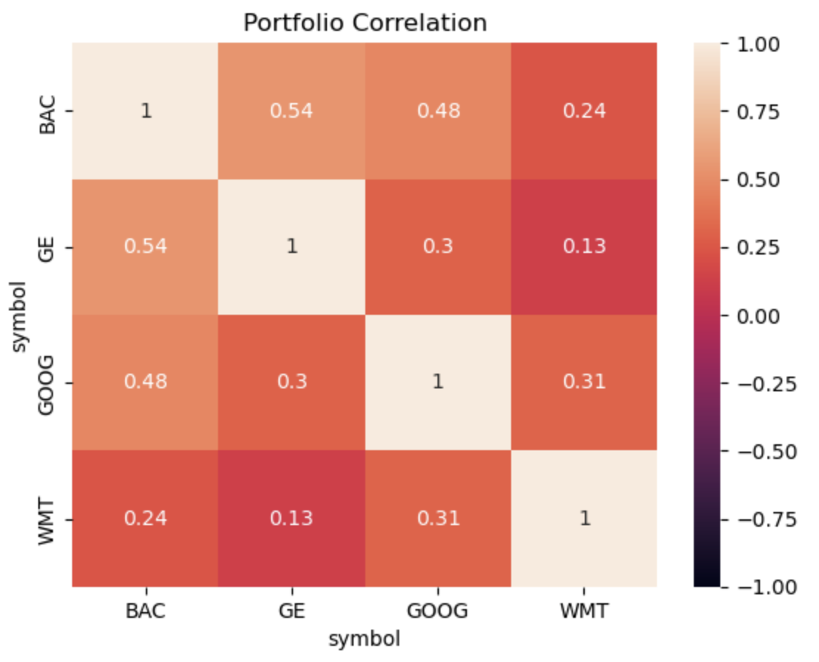

Slide 13
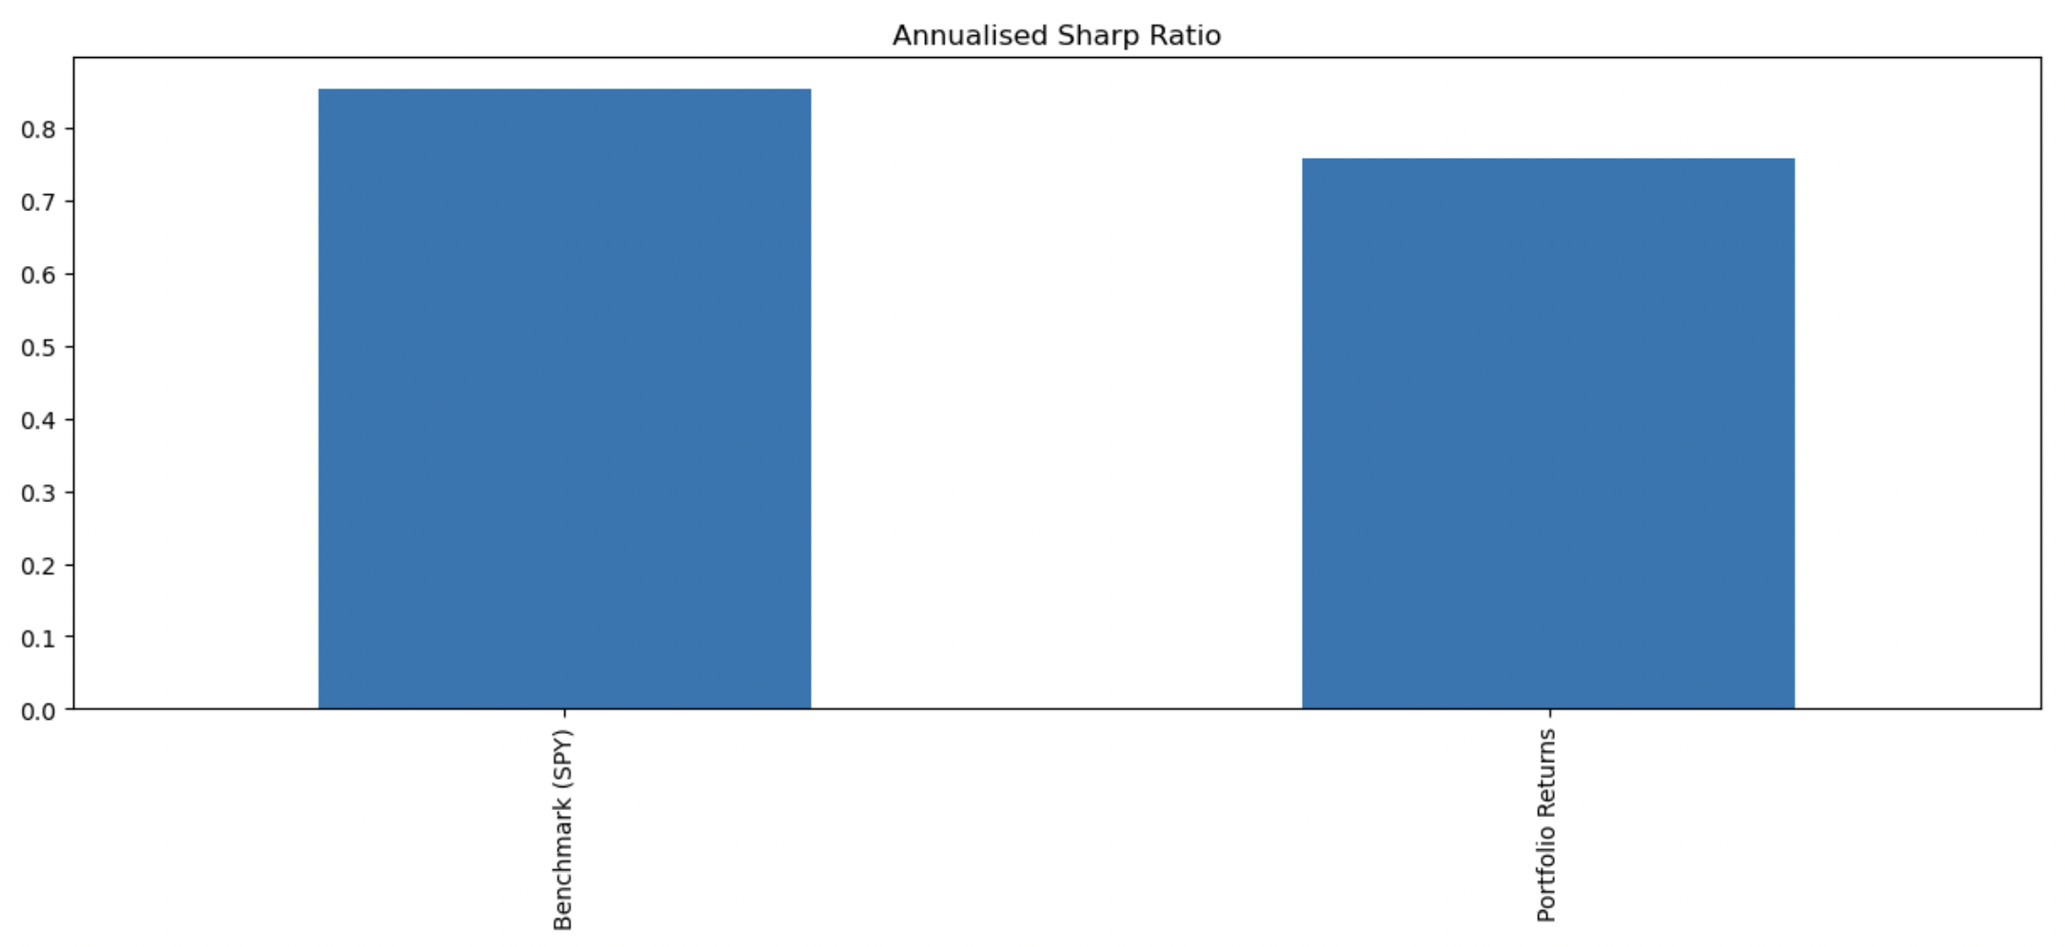
Sharp Ratio

Slide 14
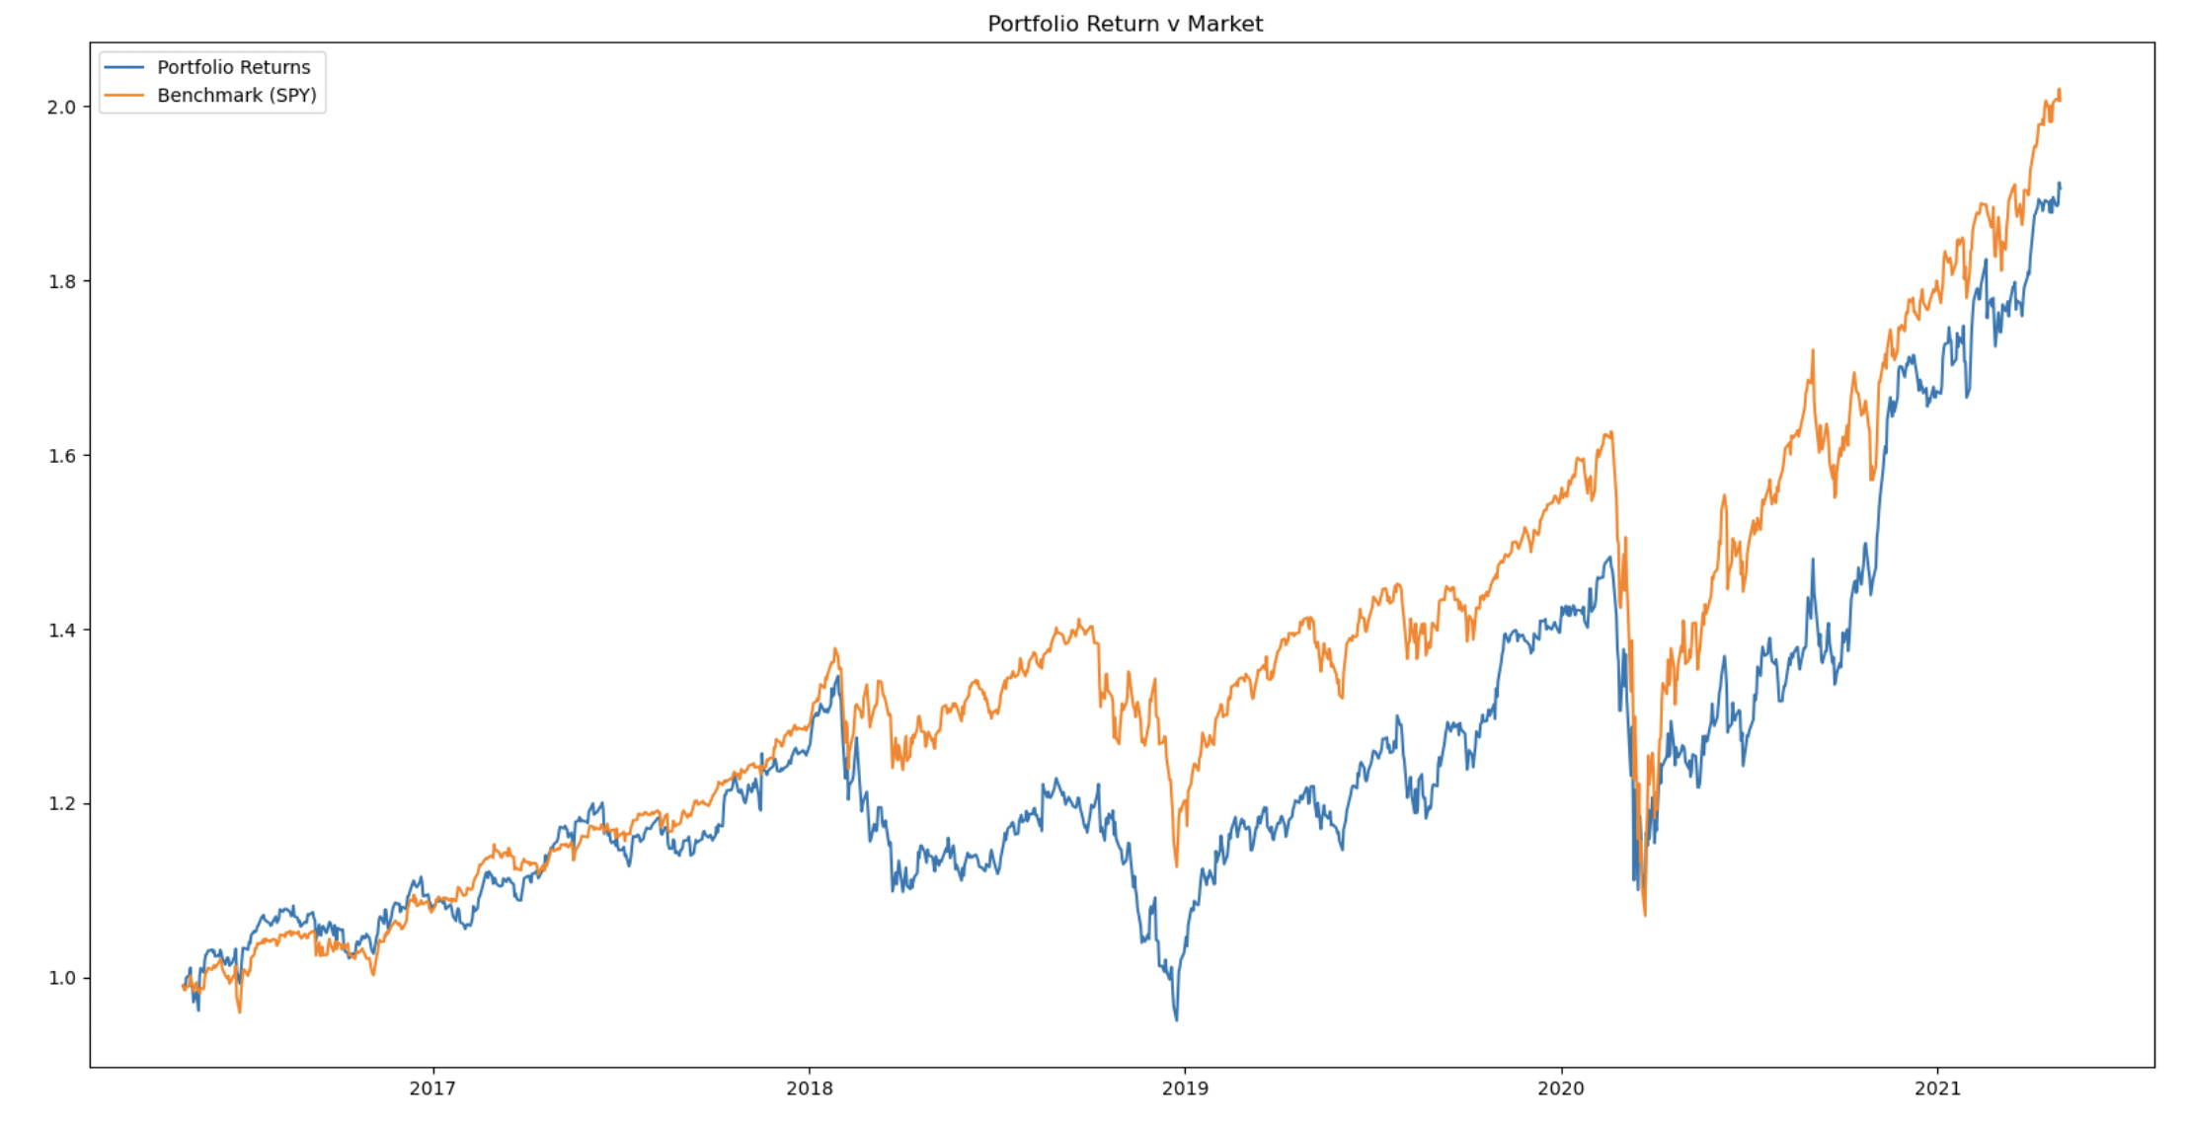
Portfolio return v Market

Slide 15
What Future Holds for Claire

Slide 16
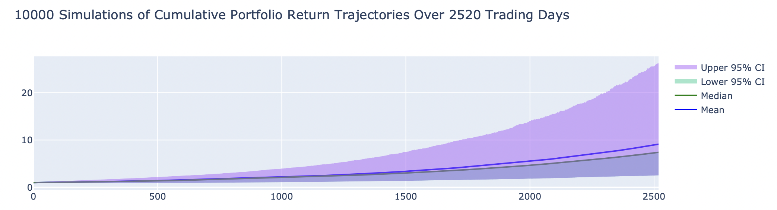

Slide 17
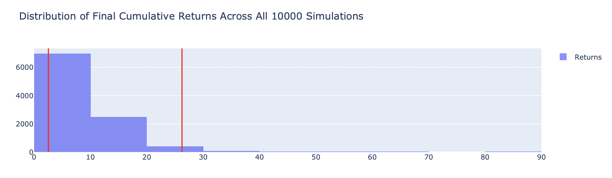

Slide 18
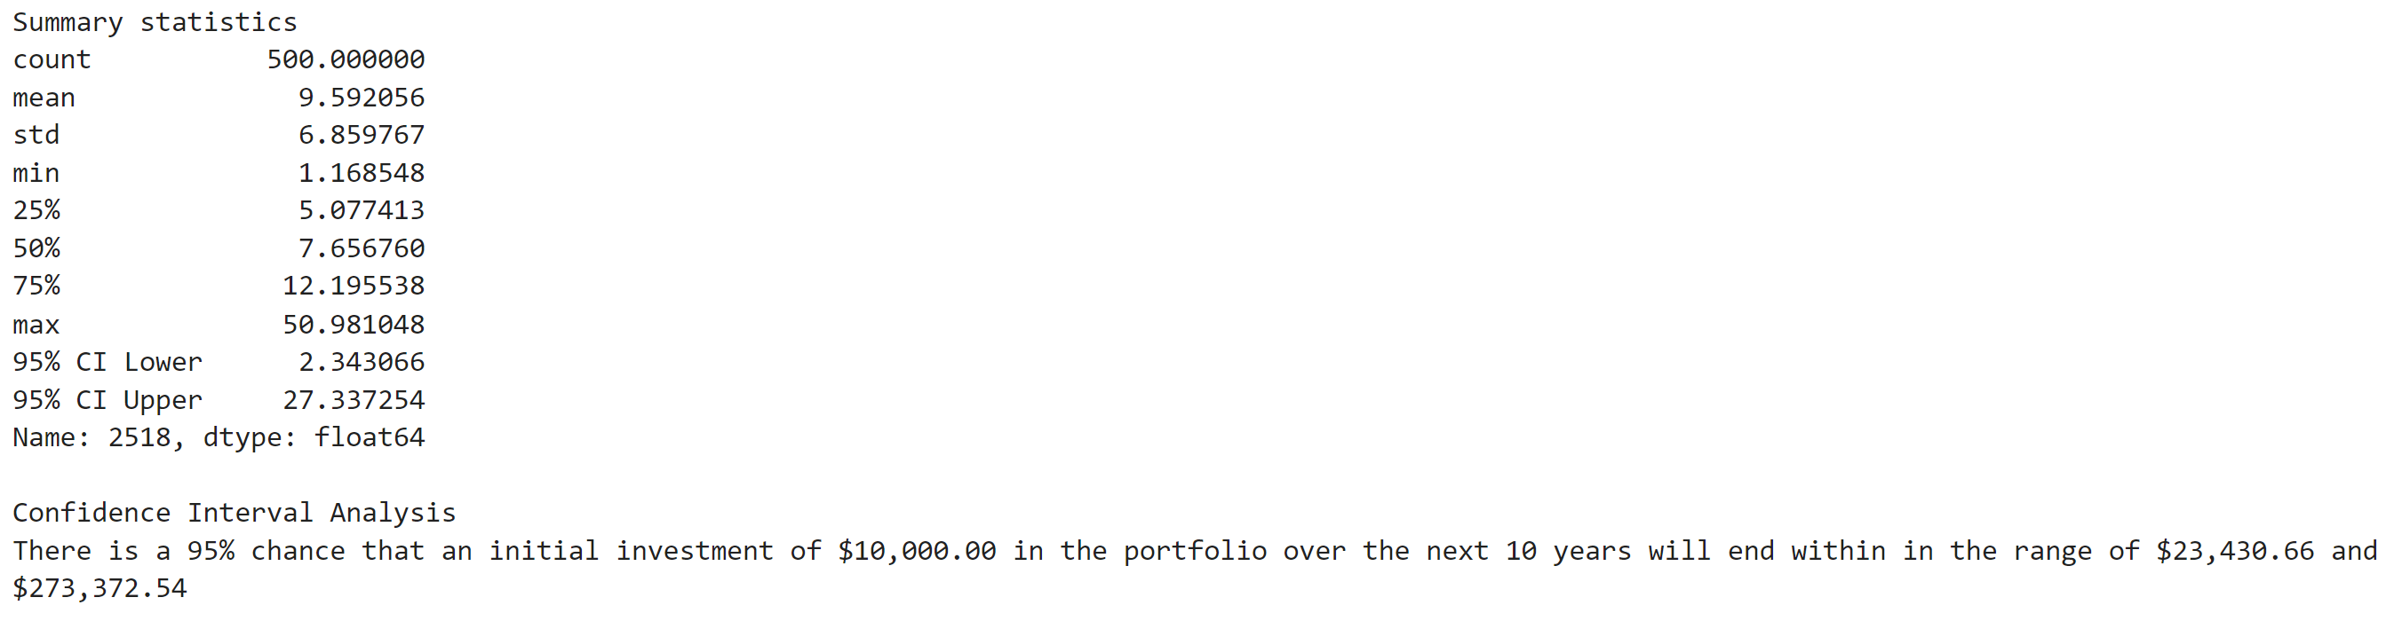
The probabilistic outcome for Claire’s portfolio is below based on analysis conducted by the system

Slide 19
What Is the Efficient Frontier?
The efficient frontier is the set of optimal portfolios that offer the highest expected return for a defined level of risk or the lowest risk for a given level of expected return.
Portfolios that lie below the efficient frontier are sub-optimal because they do not provide enough return for the level of risk.
Portfolios that cluster to the right of the efficient frontier are sub-optimal because they have a higher level of risk for the defined rate of return.

Slide 20
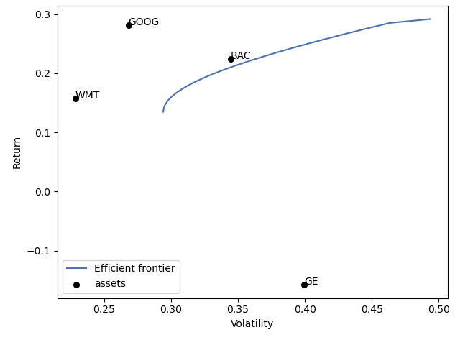
Efficient Frontier Plot

Slide 21
Data Cleanup
Had to rearrange multiple sources of data
Alpaca API to PyPortfolioOpt
PyPortfolioOpt weighting dict to
Adjusting for Stock splits
Caused confusion to algorithms used
A challenge: Future version of app to cater for this, by having stock split dates and ratios

Slide 22
Data Analysis
Discovered GOOG had a 20:1 stock split in July 2021
$10,000 invested over 10 years 95% confidence intervals Min & Max:
Own selection: $26,163.83 and $237,588.97
Efficient Frontier: $26,682.14 and $276,645.14 (16.4% better top end)

Slide 23
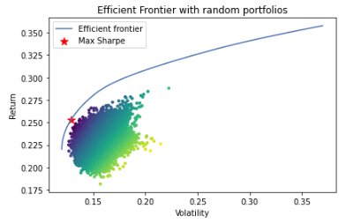
Could have…but ran out of time
Fetched more data on each stock
Integrated more of the PyPortfolioOpt functions

Slide 24
Demo - Kay

